Slide 1
Learning Objective
I will be able to solve equations involving indices
Success Criteria
At the end of the lesson, I will be able to:
equations with the unknown in the indices; and
equations with the unknown in the base (by applying fractional indices or radicals to obtain a power of 1 on the variable).

Slide 2
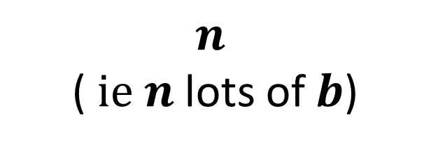
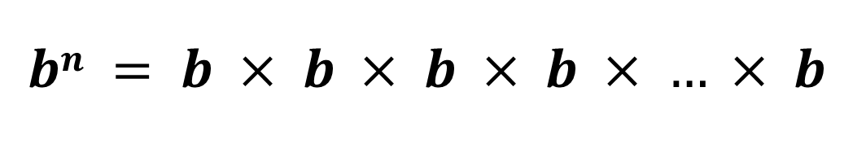

$$bn = b × b × b × b × … × b$$
Concept Development
Index Notation
Either the base or index or both can be pronumerals
$n$ ($ie n$ lots of $b$)
index (or exponent or power)
$$b n$$
base

Slide 3
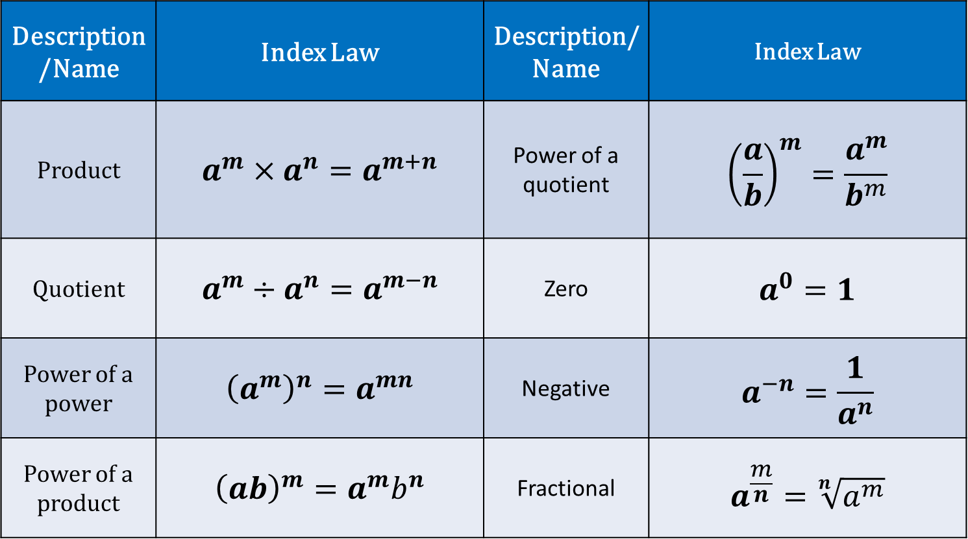
Index Laws
Description/Name | Index Law | Description/Name | Index Law
Product | $$a^{m}×a^{n}=a^{m+n}$$ | Power of a quotient | $${\left(\frac{a}{b}\right)}^{m}=\frac{a^{m}}{b^{m}}$$
Quotient | $$a^{m}÷a^{n}=a^{m−n}$$ | Zero | $$a^{0}=1$$
Power of a power | $${\left(a^{m}\right)}^{n}=a^{mn}$$ | Negative | $$a^{−n}=\frac{1}{a^{n}}$$
Power of a product | $${\left(ab\right)}^{m}=a^{m}b^{n}$$ | Fractional | $$a^{\frac{m}{n}}=\sqrt[n]{a^{m}}$$
Note: These laws applies to all integers $m$ and $n$ and non-zero numbers $a$ and$b$.

Slide 4








Guided Practice
a) $2^{x}=16$
b) $8^{x}=4$
Express 16 in terms of base 2
Express both in terms of the same base
$$2^{x}=2^{4}$$
$${\left(2^{3}\right)}^{x}=2^{2}$$
Comparing indices
$$2^{3x}=2^{2}$$
$$x=4$$
$$3x=2$$
Comparing indices
$$x=\frac{2}{3}$$

Slide 5








Guided Practice
a) ${3×5}^{x}=1 875$
b) $4^{x}−5=59$
$$5^{x}=625$$
$$4^{x}=64$$
$$5^{x}=5^{4}$$
$$4^{x}=4^{3}$$
$$x=3$$
$$x=4$$

Slide 6
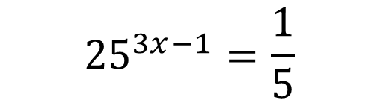






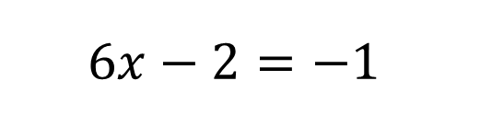

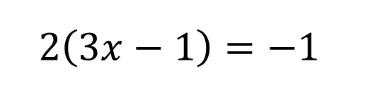

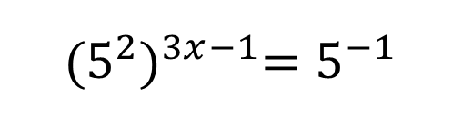
Guided Practice
a) $7^{x}=\frac{1}{343}$
b) ${25}^{3x−1}=0.2$
$${25}^{3x−1}=\frac{1}{5}$$
$$7^{x}={343}^{−1 }$$
$$7^{x}={\left(7^{3}\right)}^{−1 }$$
$${(5^{2})}^{3x−1}=5^{−1}$$
$$7^{x}=7^{−3}$$
$$2\left(3x−1\right)=−1$$
$$x=−3$$
$$6x−2=−1$$
$$6x=1$$
$$x=\frac{1}{6}$$

Slide 7








Guided Practice
a) $x^{2}=36$
b) $x^{3}=216$
$$x=±\sqrt{36}$$
$$x=6$$
$$x=±6$$
$$x^{3}=−216$$
$$x=−6$$
$$x^{n}=c$$
If $n$ is odd, then
$$x=\sqrt[n]{c}$$
If $n$ is even, then
$$x=±\sqrt[n]{c}$$

Slide 8







Guided Practice
a) $x^{0.5}=9$
b) $x^{−1}=20$
$$x^{\frac{1}{2}}=9$$
$$\frac{1}{x}=20$$
Square both sides
$$1=20x$$
$$x=81$$
$$x=\frac{1}{20}$$

Slide 9









Guided Practice
a) ${3+x}^{\frac{1}{2}}=7$
b) $\frac{x}{\sqrt{x}}=7$
$$x^{\frac{1}{2}}=4$$
$$x^{1−\frac{1}{2}}=7$$
$$x^{\frac{1}{2}}=7$$
$${\left(x^{\frac{1}{2}}\right)}^{2}=4^{2}$$
$${\left(x^{\frac{1}{2}}\right)}^{2}=7^{2}$$
$$x=16$$
$$x=49$$

Slide 10







Guided Practice
a)${(7x+1)}^{\frac{1}{2}}=8$
b) Use your classpad to solve: $2^{x}=7$
$${\left({\left(7x+1\right)}^{\frac{1}{2}}\right)}^{2}=8^{2}$$
$$7x+1=64$$
$$7x=63$$
$$x=9$$

Slide 11
Independent Practice
Complete Cambridge 14E except Q6

